Slide 1
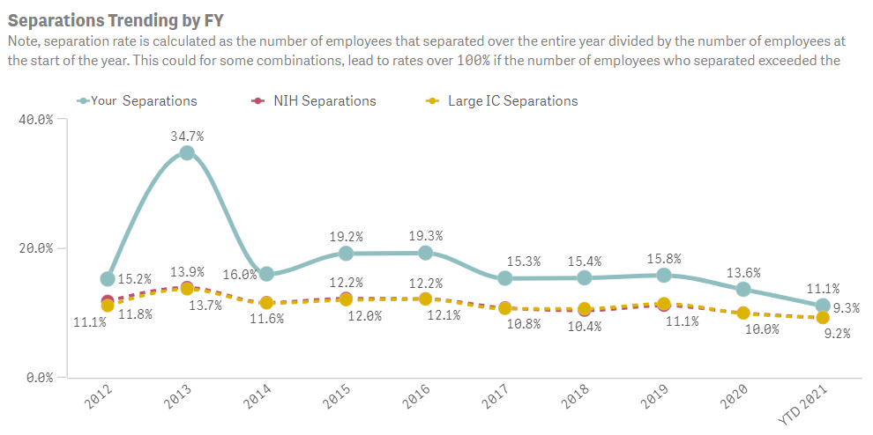
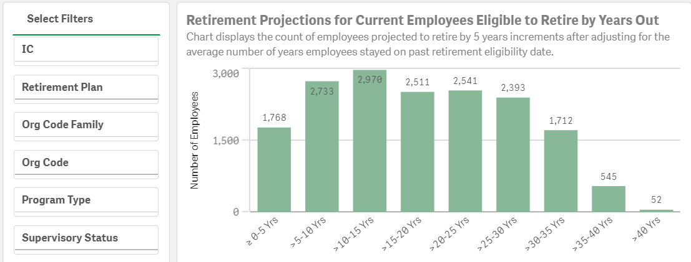
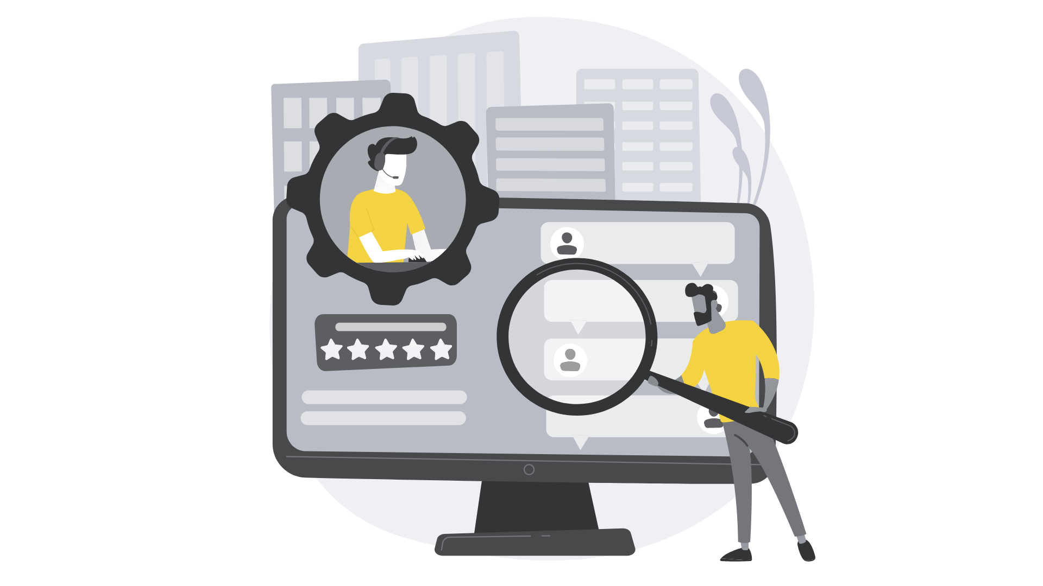
Analytics has changed, have you?
Workforce analytics empower NIH to make smarter, faster, data-driven decisions to fully optimize our workforce. OHR created the Workforce Snapshot and Workforce Analytics Workbench (WAW) dashboards to help ICs uncover trends in their workforce, plan for retirements, increase retention, and improve the employee experience.
Workforce Snapshot
The snapshot provides a view of the IC/organizational FTE workforce, with NIH-wide ICs size comparisons. The application includes a Demographic Snapshot, Turnover Snapshot, and Retirement Snapshot.
Intuitive
Dynamic easy to use dashboards with up to 13 filter options enables you to see connected relationships & trends.
Insightful
KPI measures and IC size benchmarks allow you to see your organization’s performance instantly.
Workforce Analytics Workbench (WAW)
The workbench provides a detailed breakdown of the FTE workforce. Reports included are the FTE Headcount Trends, Supervisory Status, Turnover, Retirement Eligibility, Retirement Trends, and Retirement Projections.
Proactive
With views like future retirement projections, you can start preparing your workforce to meet future challenges.
How to Access
Contact Us
Access request instructions: Qlik Analytics Access Instructions
Enter the dashboards: WAW & the Workforce Snapshot
For more information contact the Workforce Planning & Analytics Section: NIH-WORKFORCE-PLANNING@od.nih.gov

